Slide 1
Angular Training
Intermediate Level
Abhijit Simha R

Slide 2
Setup:
Node Version:
node --version
OPTUM’s npm registry: npm config set registry https://repo1.uhc.com/artifactory/api/npm/npm-virtual/ --global
Angular setup:
npm install -g @angular/cli

Slide 3
Create a workspace and initial application
Cmd: ng new my-app
No for strict type checking.
Select Yes(Y) for Routing.
Select SCSS for Styling.
Download VS code Editor. Link: https://code.visualstudio.com/download

Slide 4
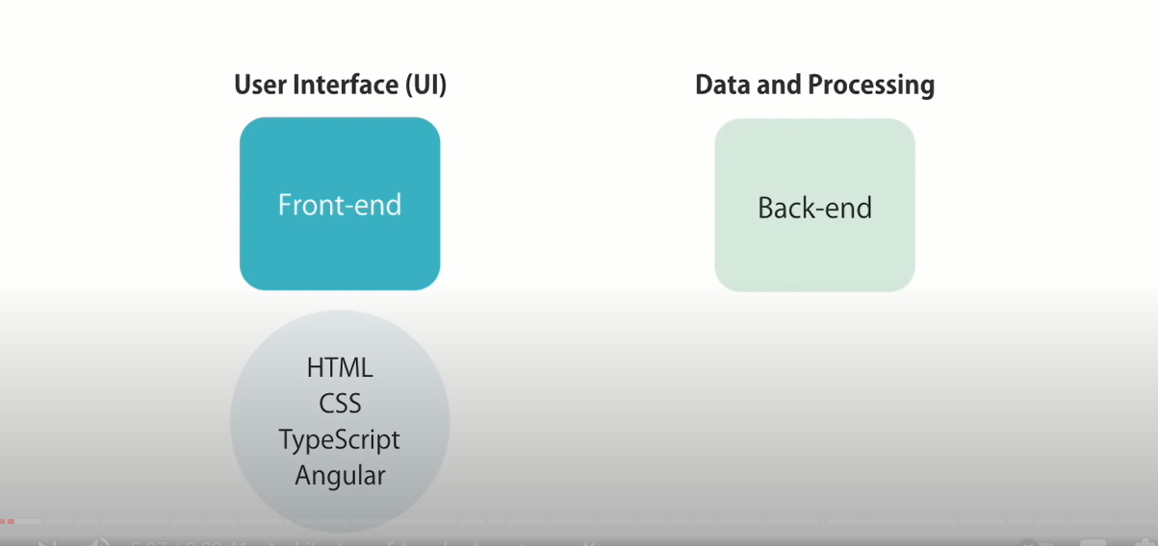
Angular Basics

Slide 5
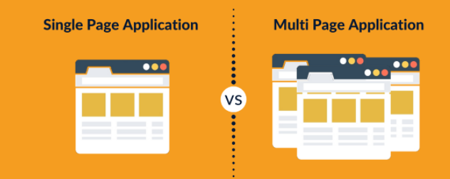
Angular Basics
Applications that are contained within one web page are called single-page applications (SPA).
All the views are displayed in one page i.e., “index.html”.

Slide 6
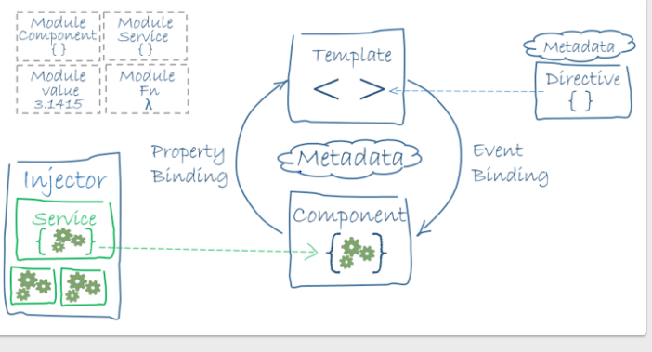
Angular Architecture
Module
Root Module

Slide 7
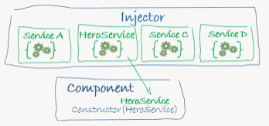
Dependency Injection

Slide 8
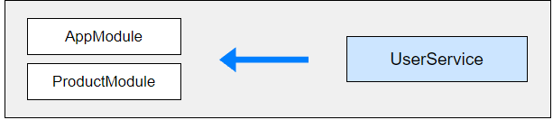

Provider Scope
Root Module Level (Application Level).
Module Level.
Component Level.
Root Module (Application Level) & Lazy Loaded Module Level (Lazy Loaded Module’s unique instance).

Slide 9
Angular Modularity
Modules are a great way to organize an application and extend it with capabilities from external libraries.
The Angular framework itself is a set of JavaScript modules.
Frequently used Angular modules :
BrowserModule
CommonModule
FormsModule
ReactiveFormsModule
RouterModule
HttpClientModule

Slide 10
Types of Modules
Root Module
Core Module
Feature Modules
Routing Modules
Shared Modules
Service Module

